Slide 1
user manual / overview
Definition of a user guide (manual)
Contents of a user guide
General guidelines for user manuals
Example(s) of different mood light user guides
User guide for your mood light
Notes:
duration: 2 min.

Slide 2
Definition of a user guide
A user guide or user's guide, also commonly known as a manual, is a technical communication document intended to give assistance to people using a particular system.
It is usually written by a technical writer.
User guides are most commonly associated with electronic goods, computer hardware and software.
Most user guides contain both a written guide and the associated images. In the case of computer applications, it is usual to include screenshots of the human-machine interface(s), and hardware manuals often include clear, simplified diagrams. The language used is matched to the intended audience, with jargon kept to a minimum or explained thoroughly.
Source: https://en.wikipedia.org/wiki/User_guide
Notes:
duration: 2 min.

Slide 3
Contents of a user guide
The sections of a user manual often include:
A cover page
A title page and copyright page
A preface, containing details of related documents and information on how to navigate the user guide
A contents page
A guide on how to use at least the main functions of the system
A troubleshooting section detailing possible errors or problems that may occur, along with how to fix them
A FAQ (Frequently Asked Questions) page
Where to find further help, and contact details
A glossary (or an index for larger documents)
Source: https://en.wikipedia.org/wiki/User_guide
Notes:
duration: 2 min.

Slide 4
General guidelines for writing user manuals
Provide a real (physical) user manual with the product: don't make people read a pdf.
Make sure the instructions actually map on to the product in all respects.
Include a one-page quick start guide.
Present instructions as step-by-step procedures.
Tell the user what functions there are, and what they are for — not just how to use them...
...but avoid marketing waffle (they already bought the product!)
Source: http://www.userfocus.co.uk/articles/usermanuals.html
Notes:
duration: 2 min.

Slide 5
General guidelines for writing user manuals
Ensure that the writers are part of the product design team.
Write the user manual in synch with the product's development timeline — not under pressure of shipping deadlines.
Make sure the writers have the product, understand the product, and actually use the product as they write.
Consider the needs of disabled users (i.e., low vision, colour-blind) and provide alternative manuals in Braille, large print, audio etc.
User-test the product and the user manual with real users (including disabled users).
Tips on how to give instructions, enhance findability, design the manual, etc. can be found e.g. here
Source: http://www.userfocus.co.uk/articles/usermanuals.html
Notes:
duration: 2 min.

Slide 6

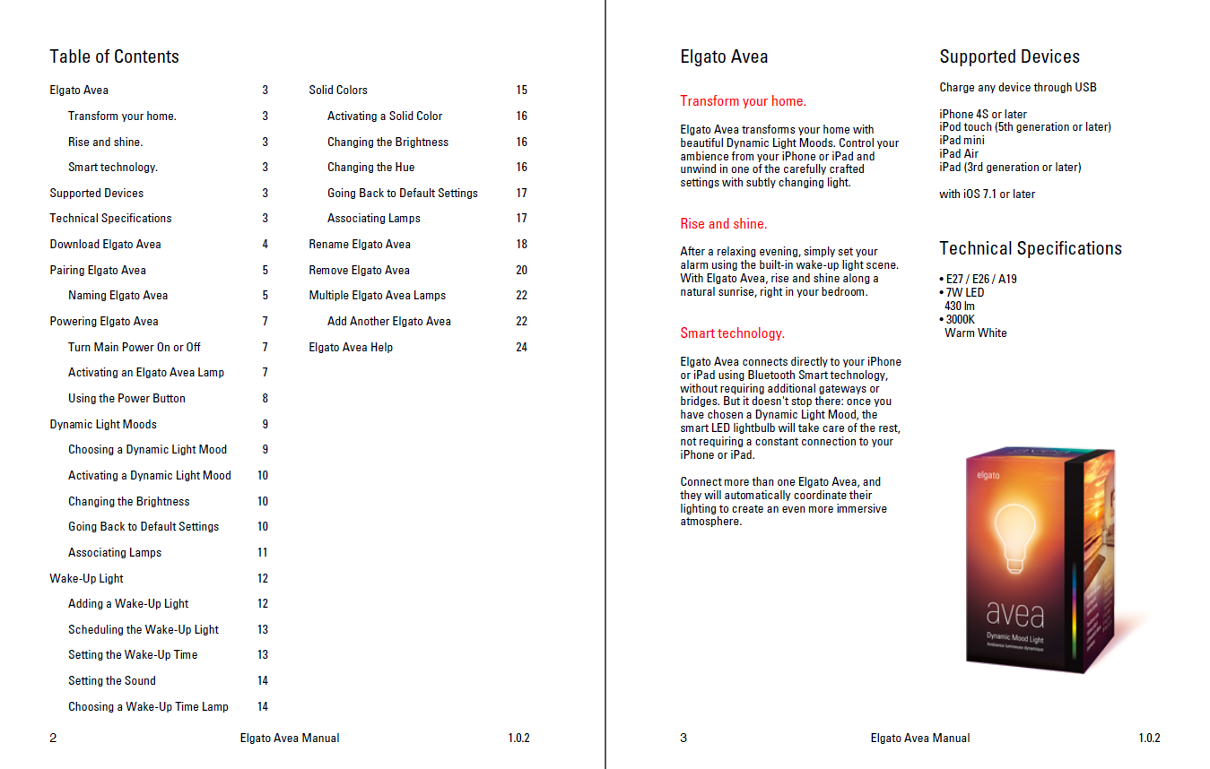

Example: Lengthy user guide for the
Elgato Avea dynamic mood light
Notes:
duration: 2 min.

Slide 7

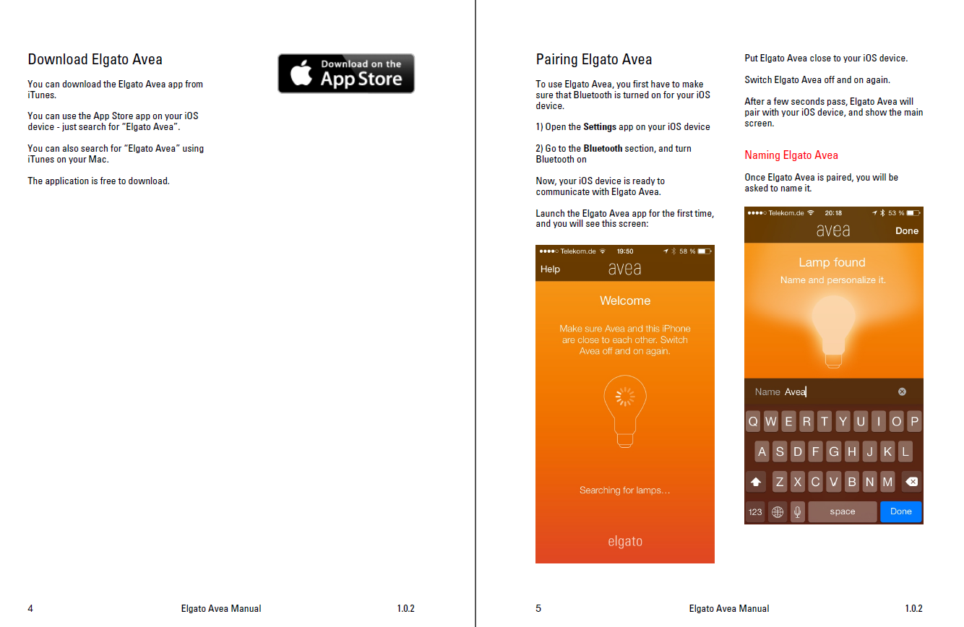
Example: Lengthy user guide for the
Elgato Avea dynamic mood light
Notes:
duration: 2 min.

Slide 8
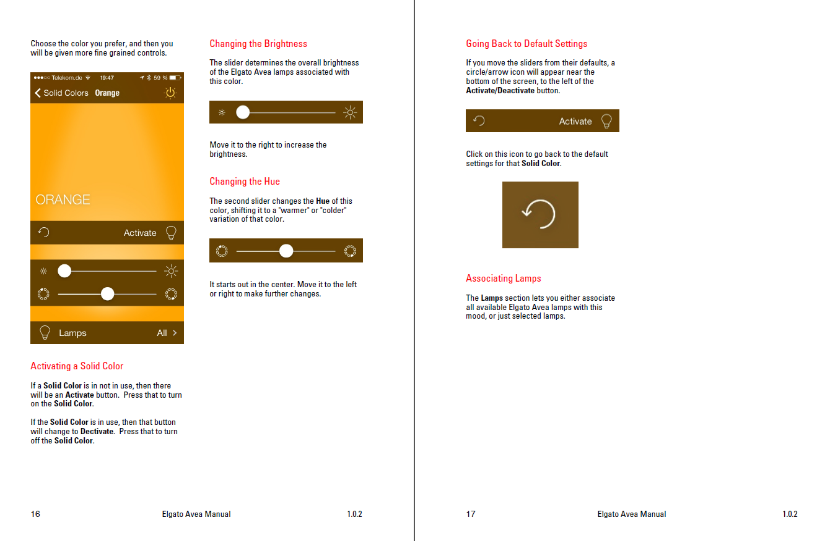
Example: Lengthy user guide for the
Elgato Avea dynamic mood light
https://help.elgato.com/customer/portal/articles/1676759-elgato-avea-manual
Notes:
duration: 2 min.

Slide 9

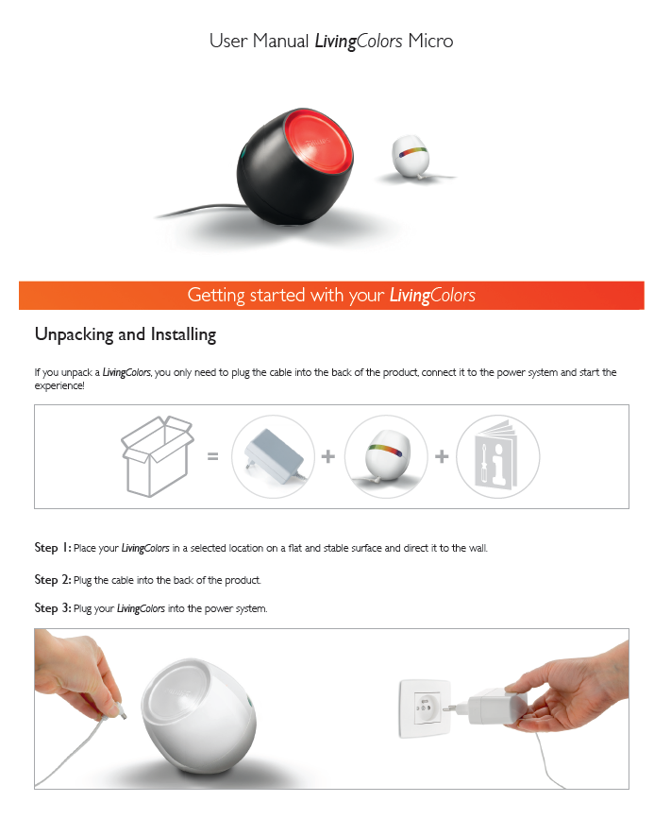
Example: Short user guide for the Philips
Living Colors Micro simple mood light
Notes:
duration: 2 min.

Slide 10
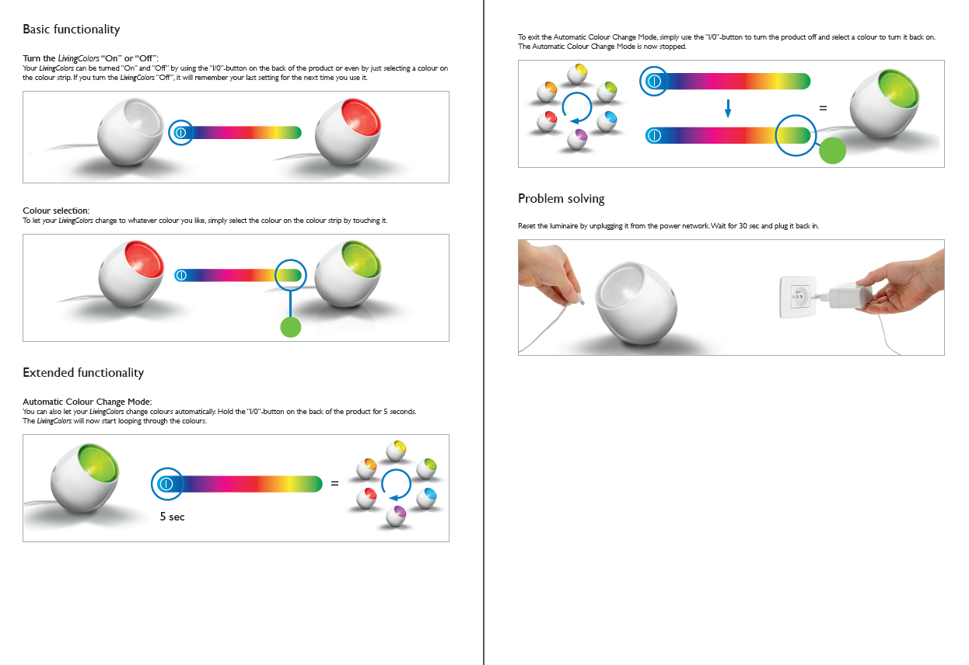
Example: Short user guide for the Philips
Living Colors Micro simple mood light
http://www.philips.co.uk/c-p/7001831PU/livingcolors-table-lamp/support
Notes:
duration: 2 min.

Slide 11
User guide for your mood light
We assume that
the LEDs with the lampshade and the controller are a working unit
the installation of the APP on your mobile phone must be explained in your user guide
the user guide must describe all the functionality of your mood light
the user guide should consist of about 4 pages.
Notes:
duration: 2 min.

